Slide 1


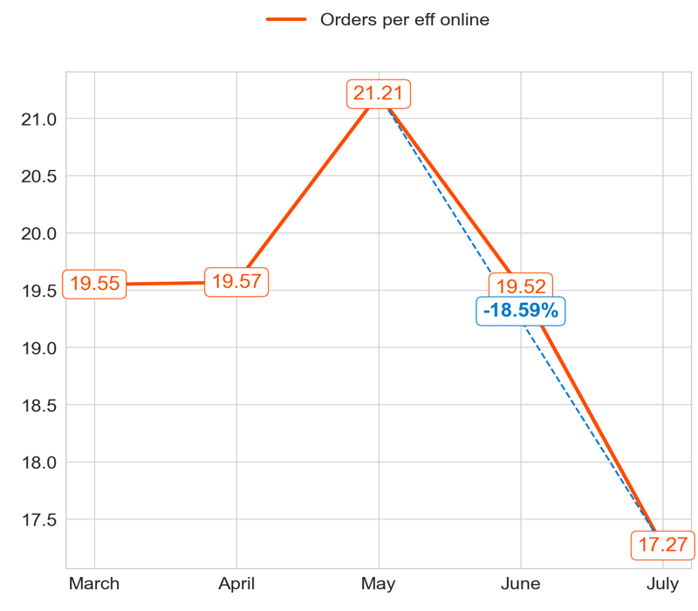
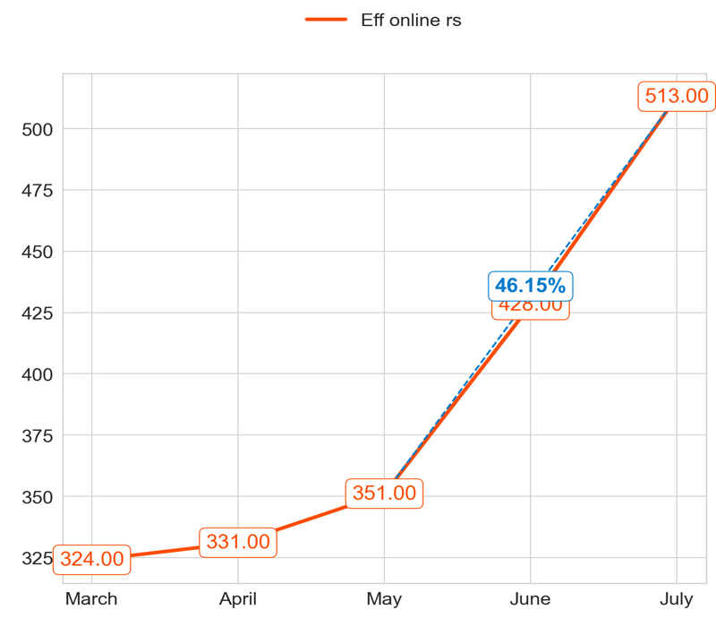
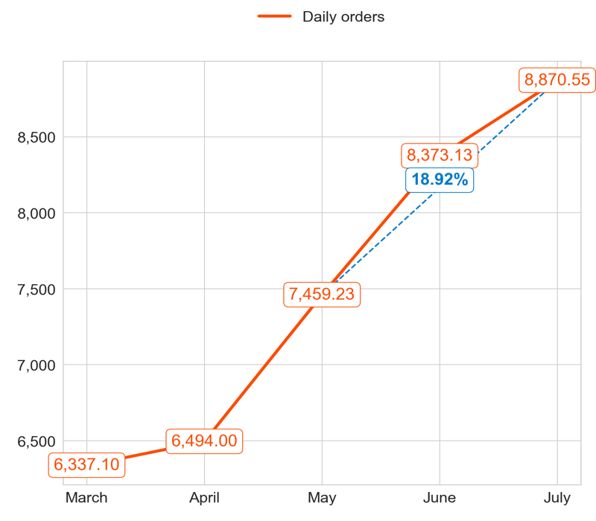
PERFORMANCE
Action Title
Priority 1 -
Comments
Highest: 21.21, Lowest: 17.27
Mean of the last 4 months: 19.39
Highest: 513.00, Lowest: 324.00
Mean of the last 4 months: 405.75
Highest: 8,870.55, Lowest: 6,337.10
Mean of the last 4 months: 7,799.23

Slide 2
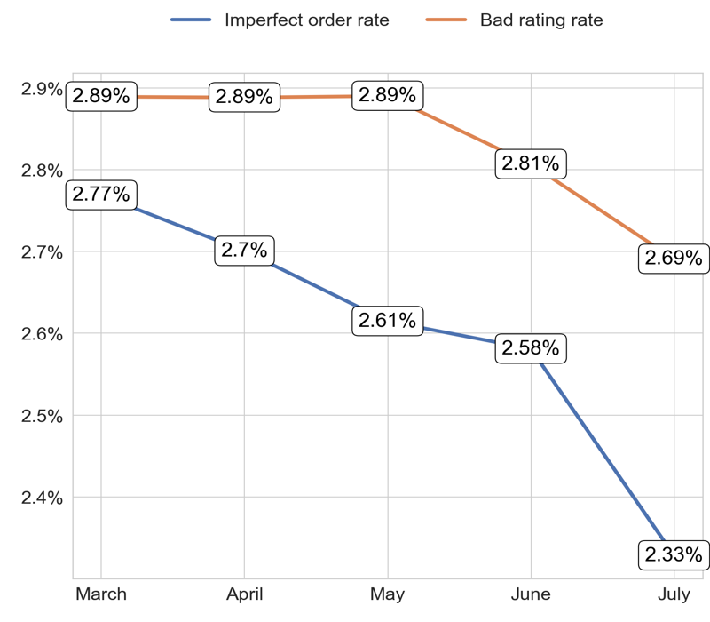
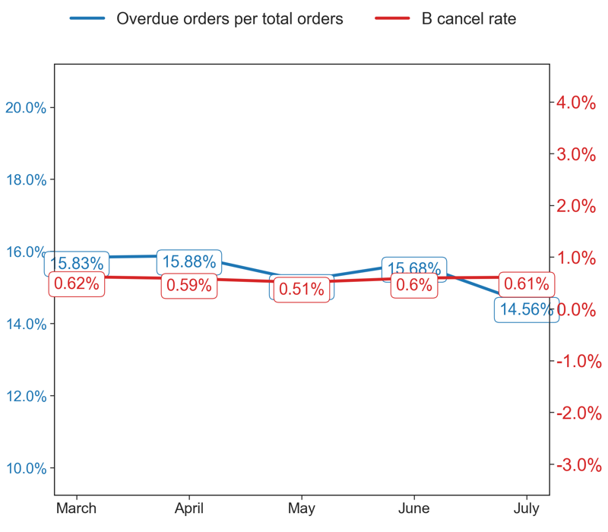
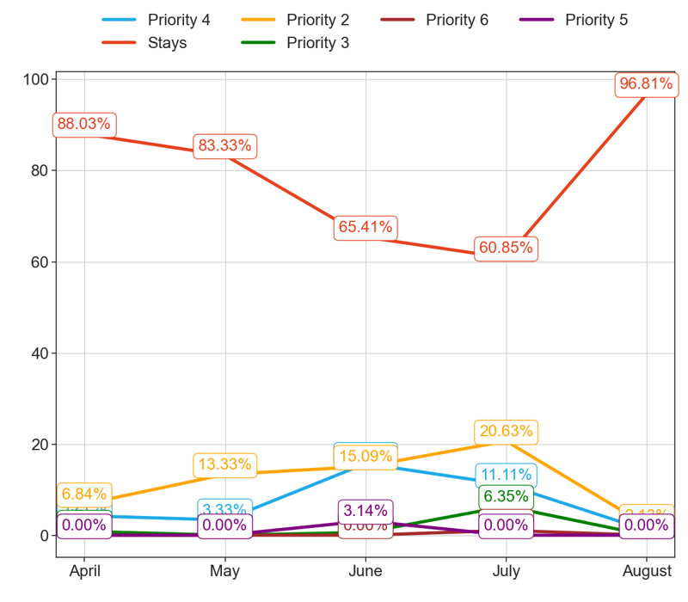
SERVICE
Action Title
Priority 1 -
Comments
Imperfect order rate average in the last 4 months: 2.6 % and the percentage change between the last 2 months: -9.67%.
Bad rating rate average in the last 4 months: 2.83 % and the percentage change between the last 2 months: -4.01%.
Overdue orders per total orders average in the last 4 months: 15.43 % and the percentage change between the last 2 months: -7.35%.
B cancel rate average in the last 4 months: 0.59 % and the percentage change between the last 2 months: 3.4%.
No comments

Slide 3
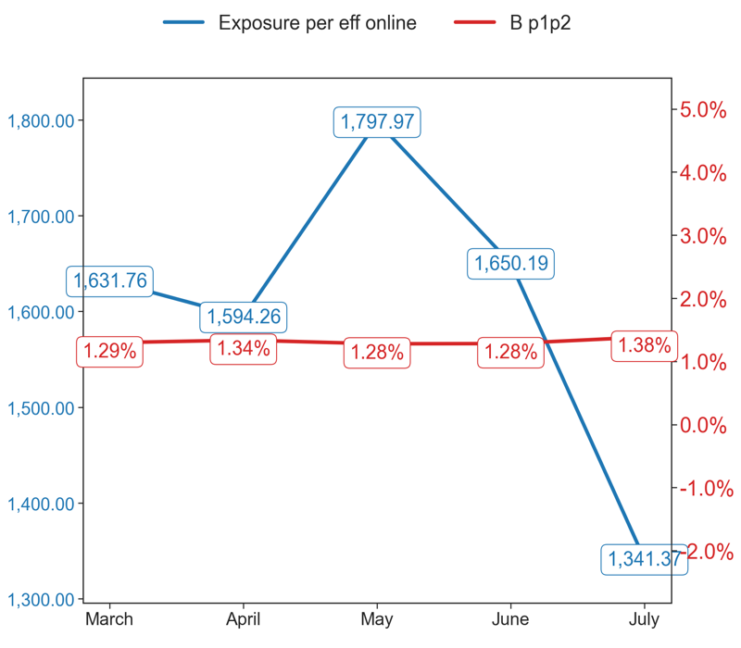
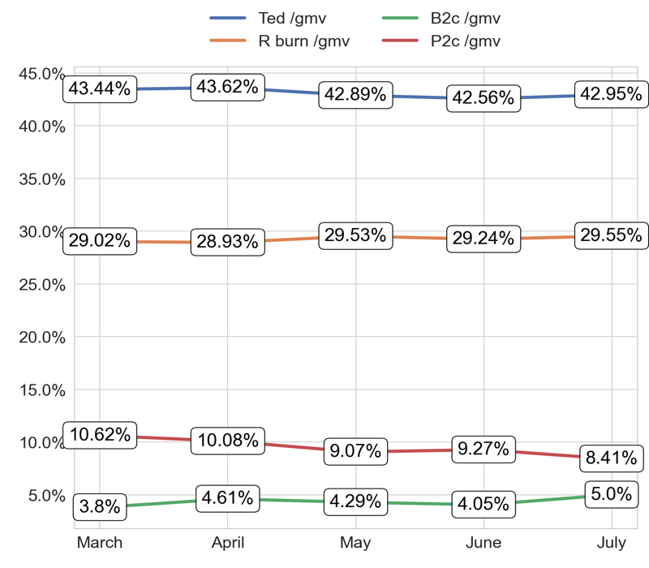
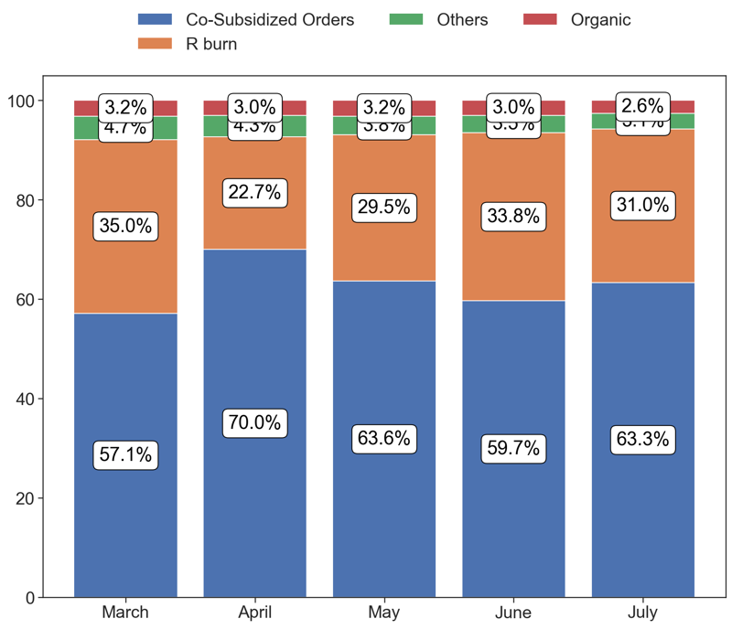
EXPOSURE AND BURN
Action Title
Priority 1 -
Comments
Exposure per eff online average in the last 4 months: 160310.95 % and the percentage change between the last 2 months: -17.18%.
B p1p2 average in the last 4 months: 1.32 % and the percentage change between the last 2 months: 8.03%.
No comments
Last Month Data:
Co-Subsidized Orders: 5,614 orders
R burn: 2,748 orders
Others: 279 orders
Organic: 229 orders

Slide 4
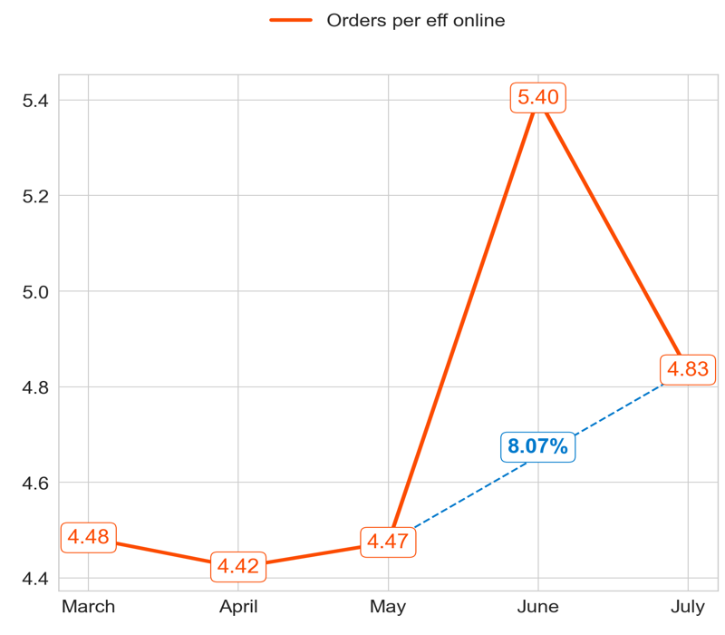
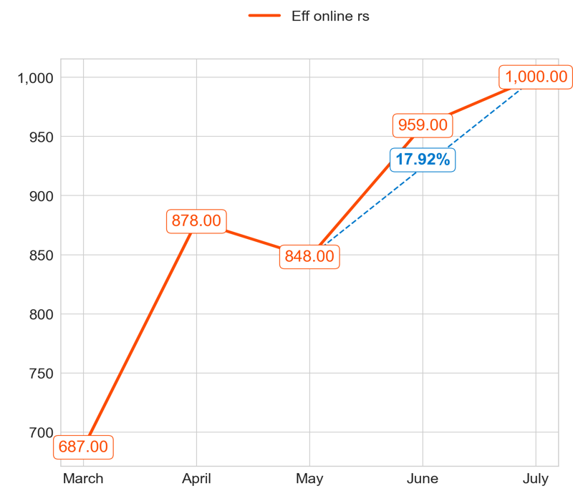
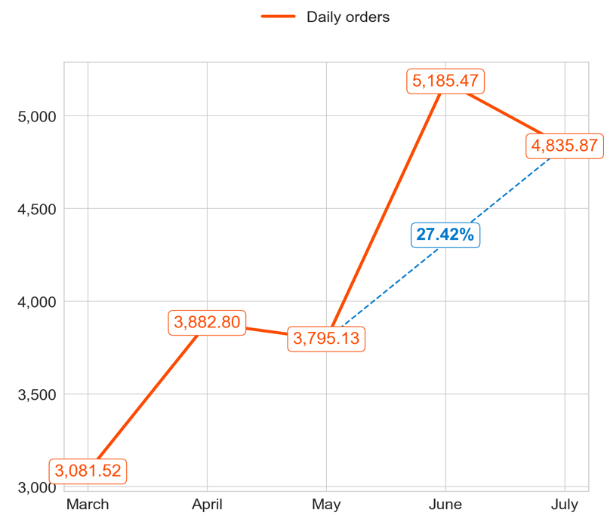
PERFORMANCE
Action Title
Priority 2 -
Comments
Highest: 5.40, Lowest: 4.42
Mean of the last 4 months: 4.78
Highest: 1,000.00, Lowest: 687.00
Mean of the last 4 months: 921.25
Highest: 5,185.47, Lowest: 3,081.52
Mean of the last 4 months: 4,424.82

Slide 5
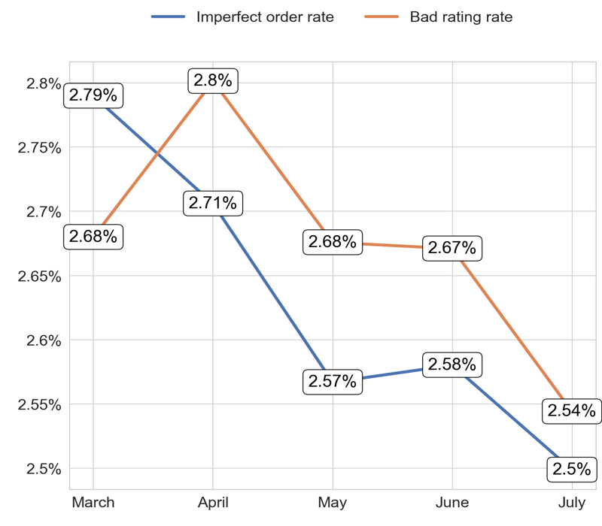
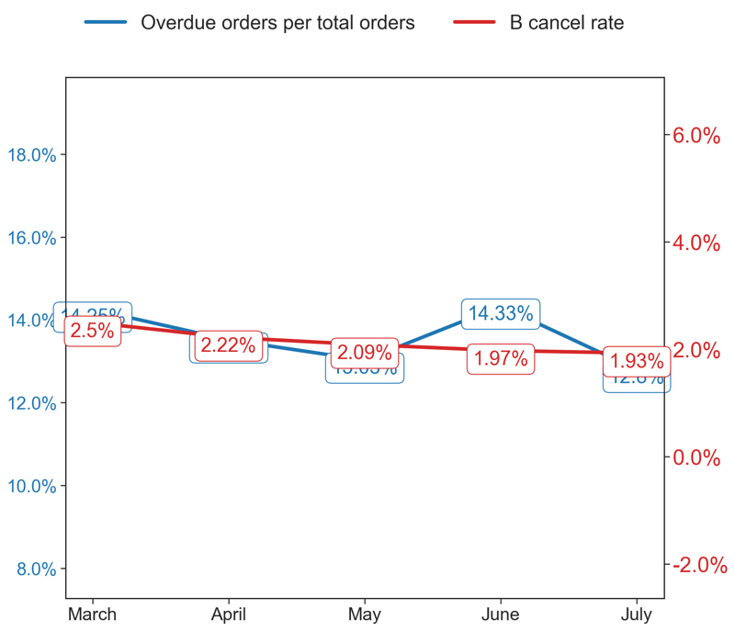
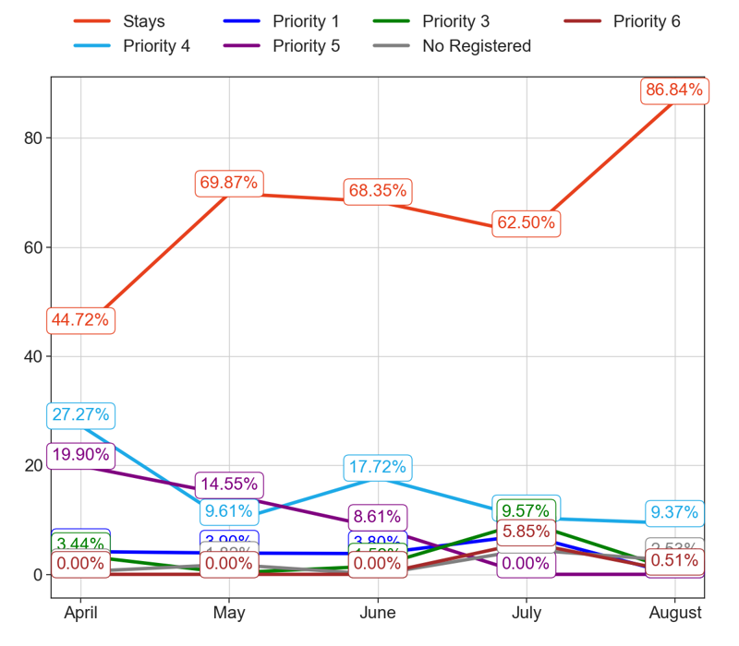
SERVICE
Action Title
Priority 2 -
Comments
Imperfect order rate average in the last 4 months: 2.63 % and the percentage change between the last 2 months: -3.17%.
Bad rating rate average in the last 4 months: 2.67 % and the percentage change between the last 2 months: -4.74%.
Overdue orders per total orders average in the last 4 months: 13.58 % and the percentage change between the last 2 months: -11.74%.
B cancel rate average in the last 4 months: 2.14 % and the percentage change between the last 2 months: -2.24%.
No comments

Slide 6
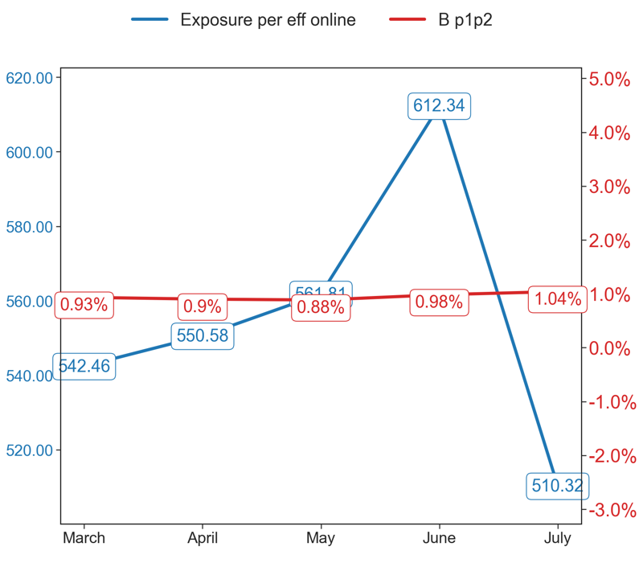
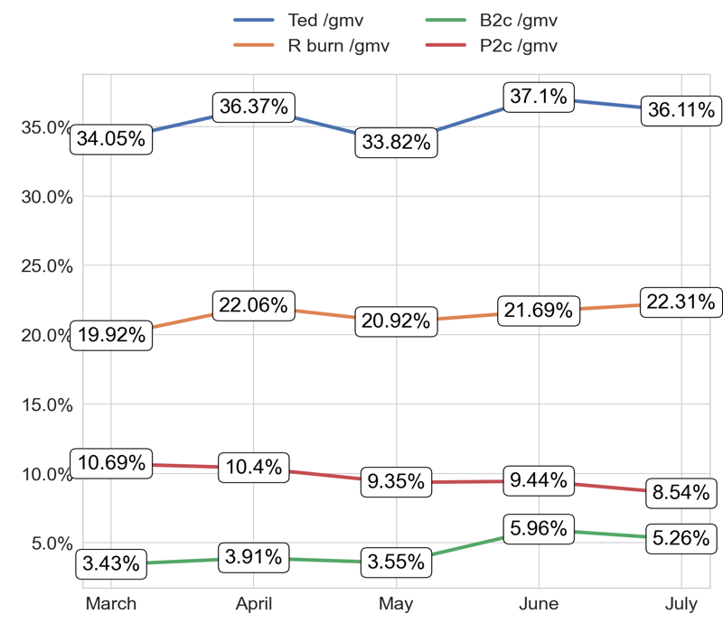
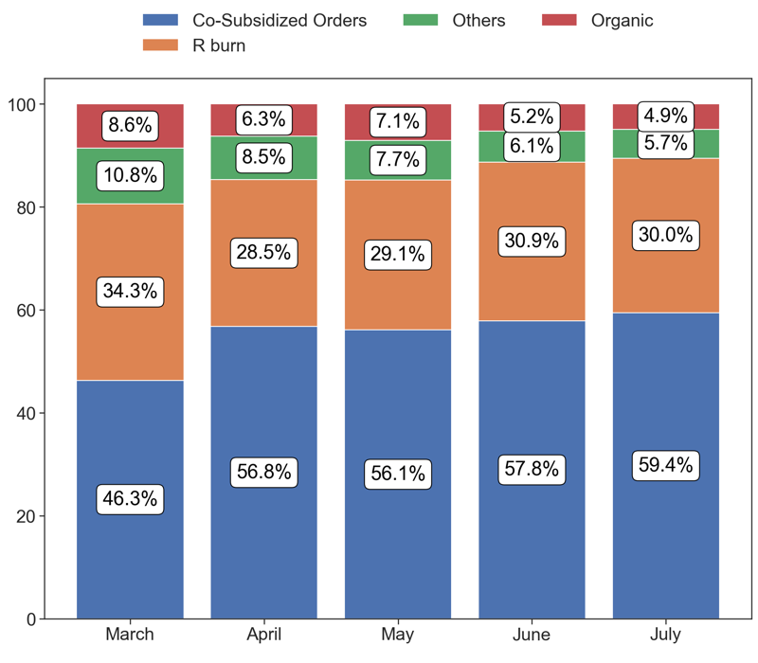
EXPOSURE AND BURN
Action Title
Priority 2 -
Comments
Exposure per eff online average in the last 4 months: 55550.58 % and the percentage change between the last 2 months: -18.16%.
B p1p2 average in the last 4 months: 0.95 % and the percentage change between the last 2 months: 6.59%.
No comments
Last Month Data:
Co-Subsidized Orders: 2,923 orders
R burn: 1,476 orders
Others: 278 orders
Organic: 242 orders

Slide 7
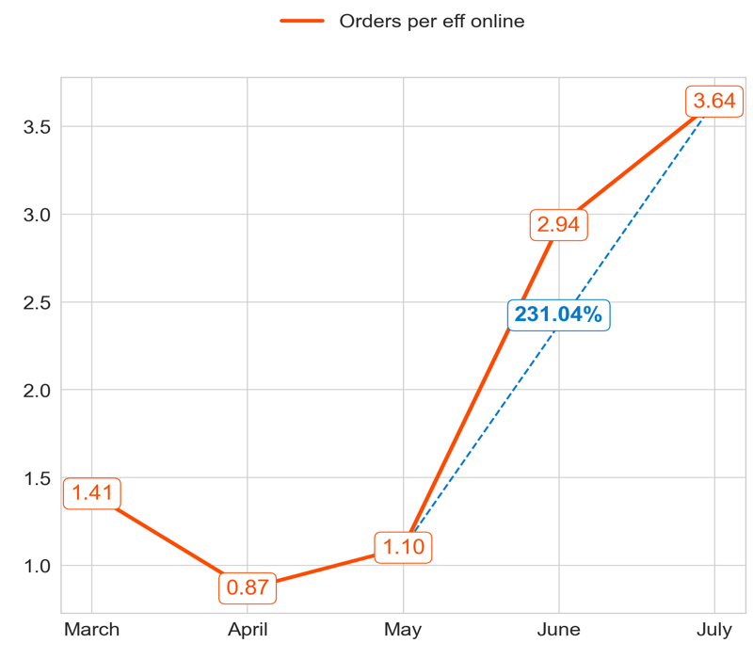
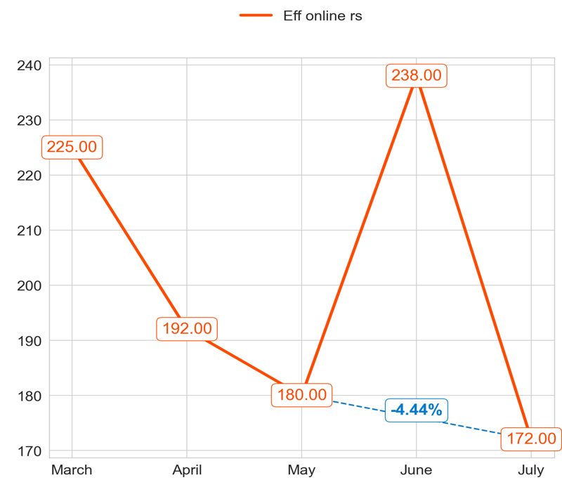
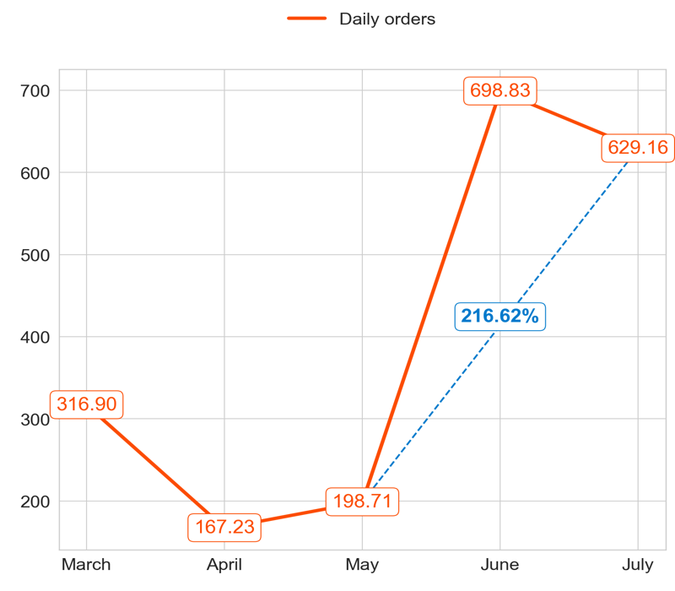
PERFORMANCE
Action Title
Priority 3 -
Comments
Highest: 3.64, Lowest: 0.87
Mean of the last 4 months: 2.14
Highest: 238.00, Lowest: 172.00
Mean of the last 4 months: 195.50
Highest: 698.83, Lowest: 167.23
Mean of the last 4 months: 423.48

Slide 8
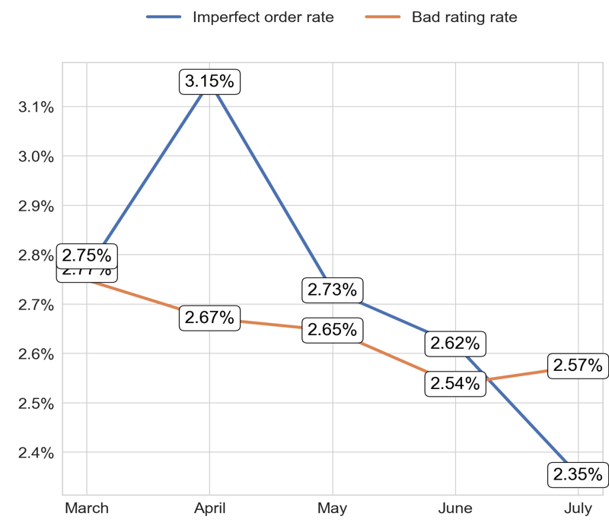
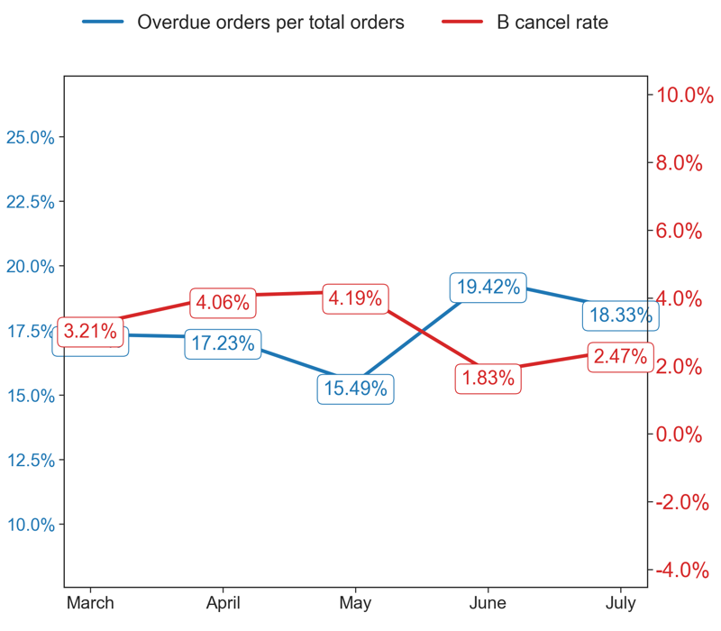
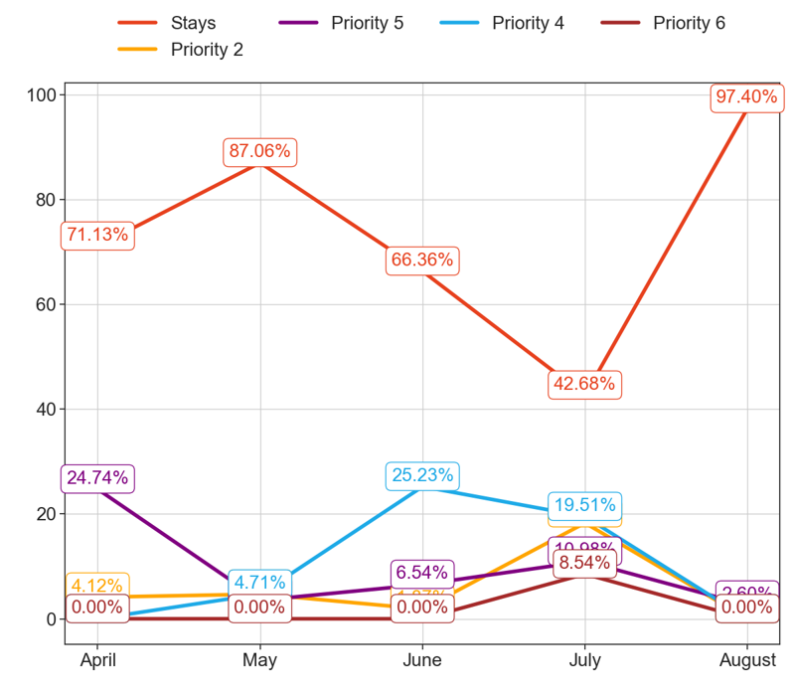
SERVICE
Action Title
Priority 3 -
Comments
Imperfect order rate average in the last 4 months: 2.72 % and the percentage change between the last 2 months: -9.73%.
Bad rating rate average in the last 4 months: 2.64 % and the percentage change between the last 2 months: 1.37%.
Overdue orders per total orders average in the last 4 months: 17.56 % and the percentage change between the last 2 months: -7.04%.
B cancel rate average in the last 4 months: 3.15 % and the percentage change between the last 2 months: 15.2%.
No comments

Slide 9
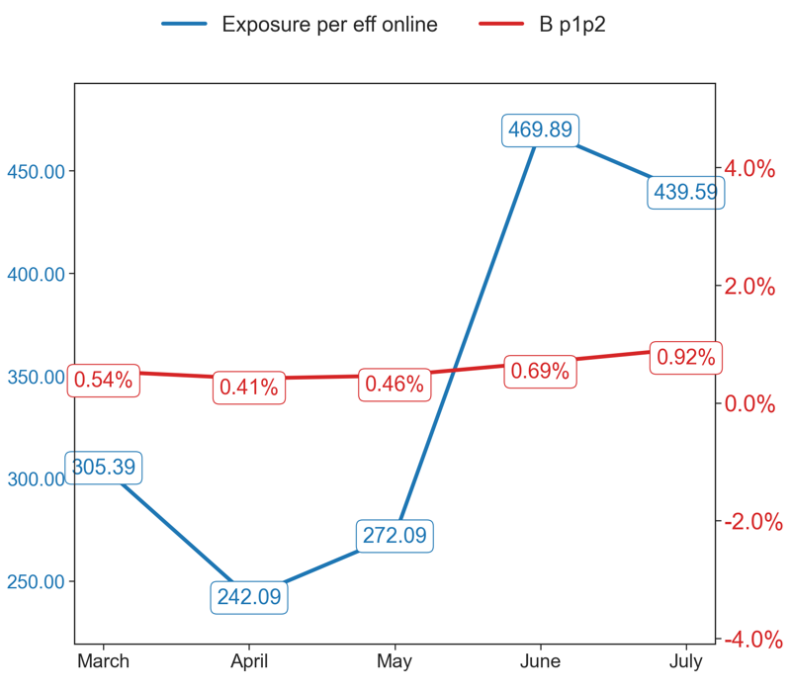
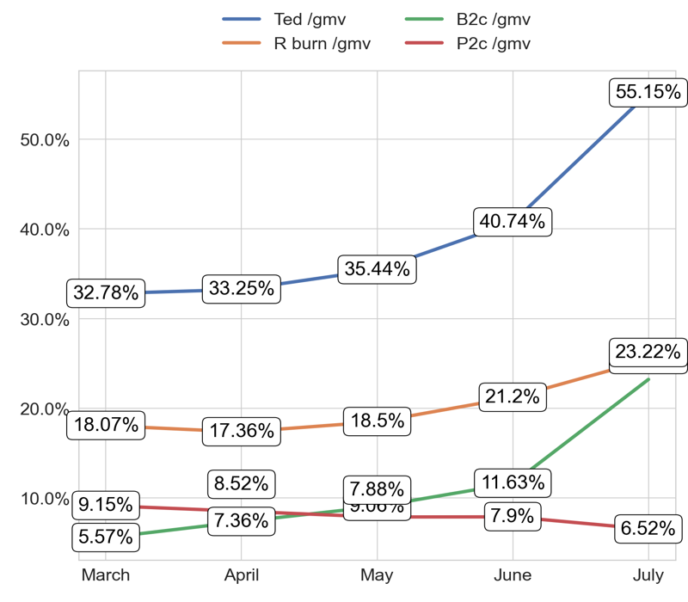
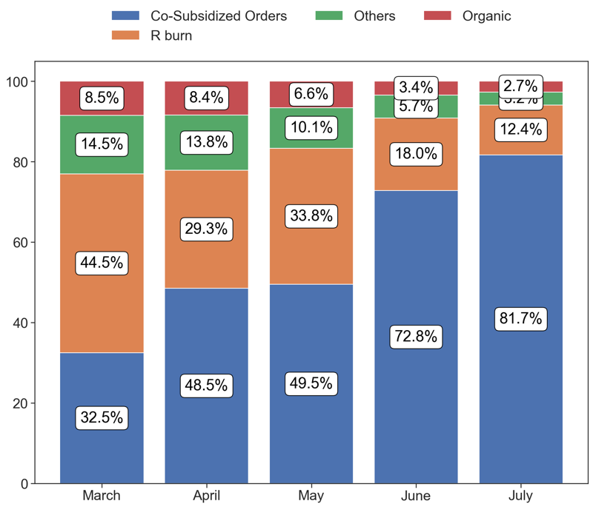
EXPOSURE AND BURN
Action Title
Priority 3 -
Comments
Exposure per eff online average in the last 4 months: 34581.09 % and the percentage change between the last 2 months: -11.14%.
B p1p2 average in the last 4 months: 0.6 % and the percentage change between the last 2 months: 50.89%.
No comments
Last Month Data:
Co-Subsidized Orders: 513 orders
R burn: 78 orders
Others: 20 orders
Organic: 17 orders

Slide 10
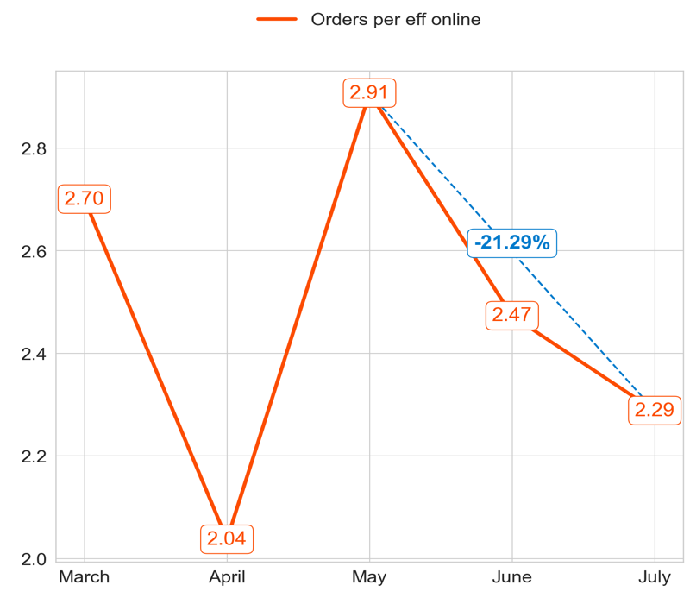
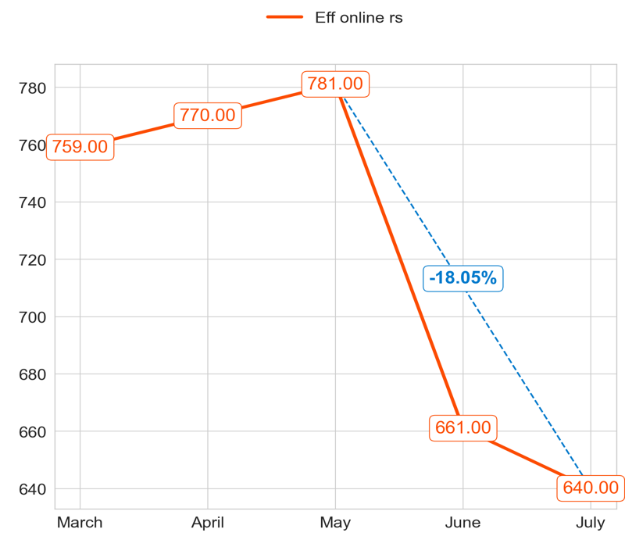
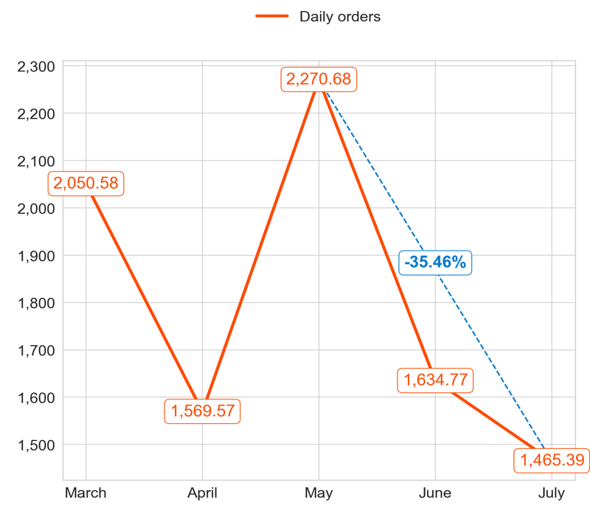
PERFORMANCE
Action Title
Priority 4 -
Comments
Highest: 2.91, Lowest: 2.04
Mean of the last 4 months: 2.43
Highest: 781.00, Lowest: 640.00
Mean of the last 4 months: 713.00
Highest: 2,270.68, Lowest: 1,465.39
Mean of the last 4 months: 1,735.10

Slide 11
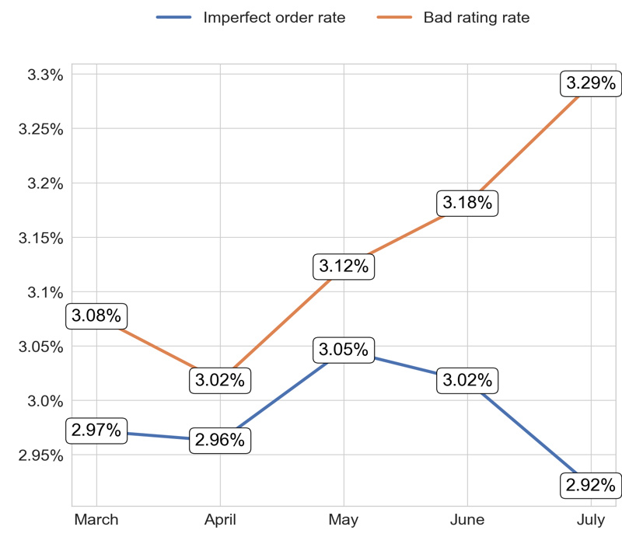
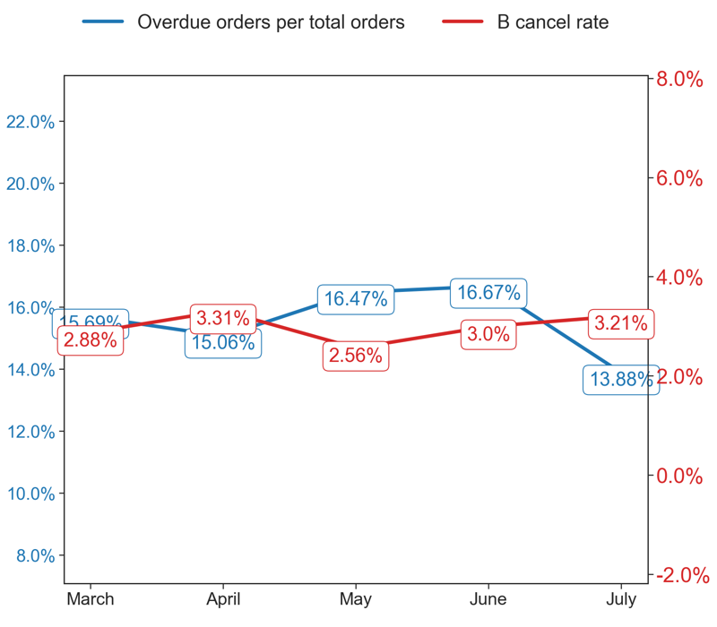
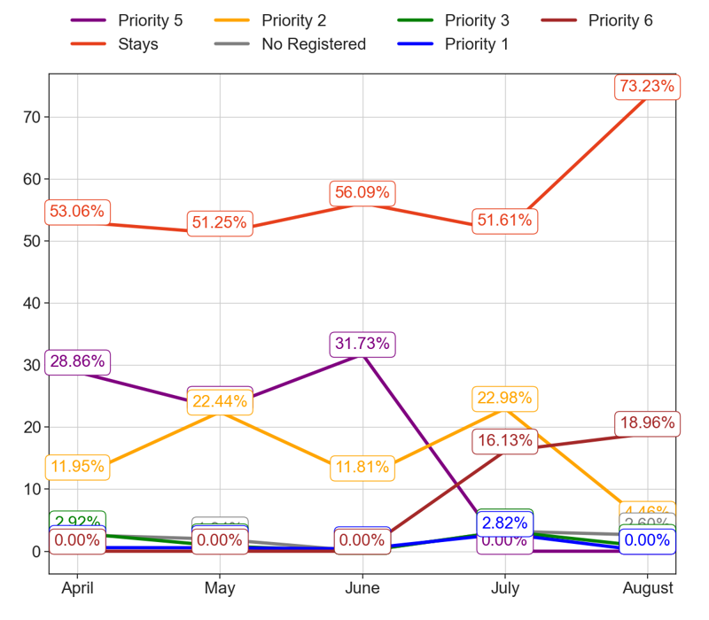
SERVICE
Action Title
Priority 4 -
Comments
Imperfect order rate average in the last 4 months: 2.98 % and the percentage change between the last 2 months: -3.17%.
Bad rating rate average in the last 4 months: 3.14 % and the percentage change between the last 2 months: 3.53%.
Overdue orders per total orders average in the last 4 months: 15.56 % and the percentage change between the last 2 months: -16.95%.
B cancel rate average in the last 4 months: 2.99 % and the percentage change between the last 2 months: 8.28%.
No comments

Slide 12
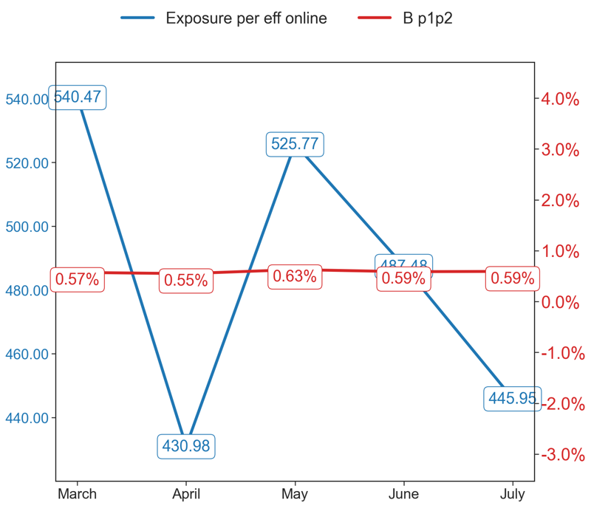
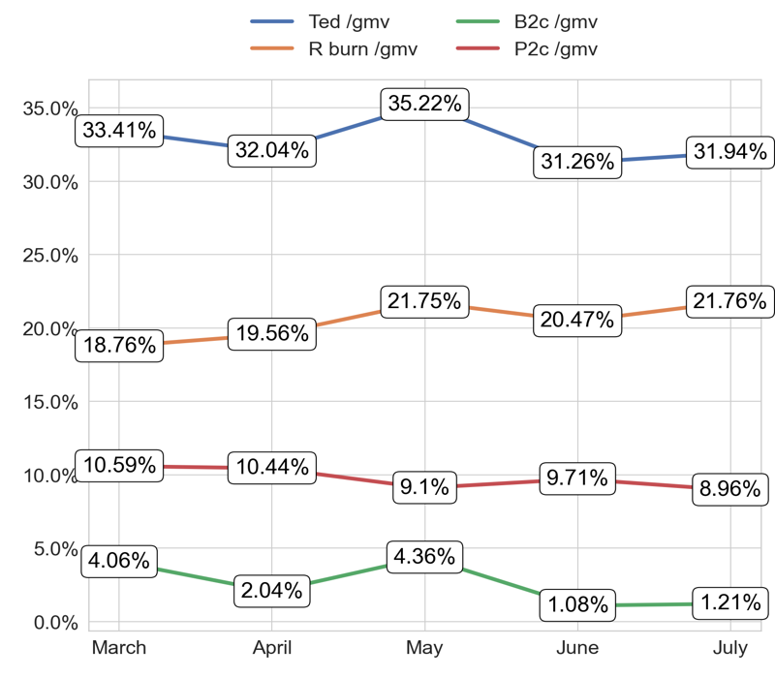
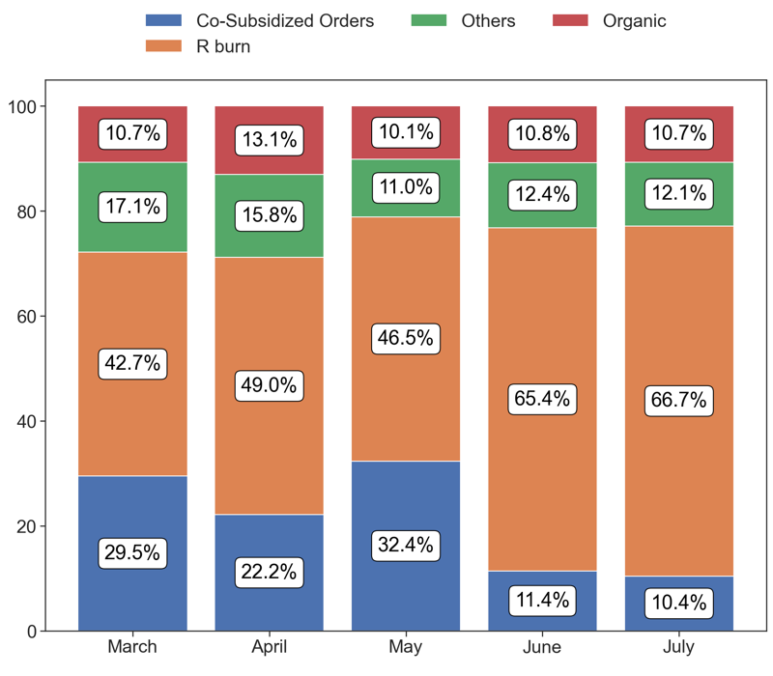
EXPOSURE AND BURN
Action Title
Priority 4 -
Comments
Exposure per eff online average in the last 4 months: 48612.92 % and the percentage change between the last 2 months: -7.9%.
B p1p2 average in the last 4 months: 0.59 % and the percentage change between the last 2 months: 0.95%.
No comments
Last Month Data:
Co-Subsidized Orders: 153 orders
R burn: 979 orders
Others: 178 orders
Organic: 157 orders

Slide 13
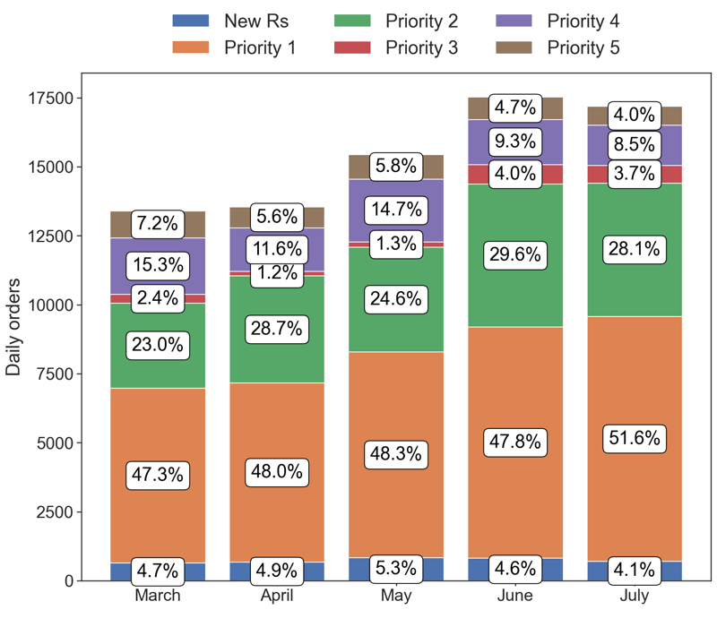
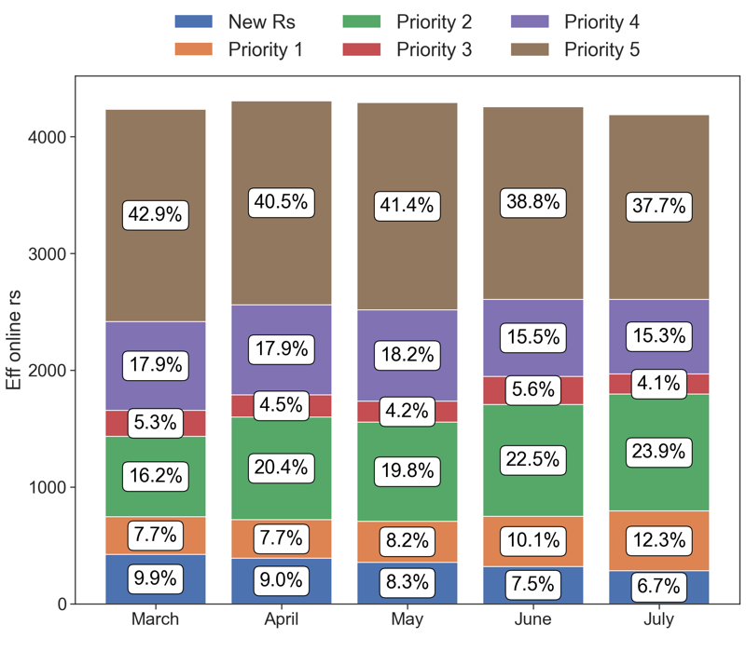
PERFORMANCE
Action Title
Country overview -
Comments
Last Month Data:
New Rs: 699.39, Priority 1: 8,870.55, Priority 2: 4,835.87, Priority 3: 629.16, Priority 4: 1,465.39, Priority 5: 682.97
Last Month Data:
New Rs: 281.00, Priority 1: 513.00, Priority 2: 1,000.00, Priority 3: 172.00, Priority 4: 640.00, Priority 5: 1,579.00

Slide 14

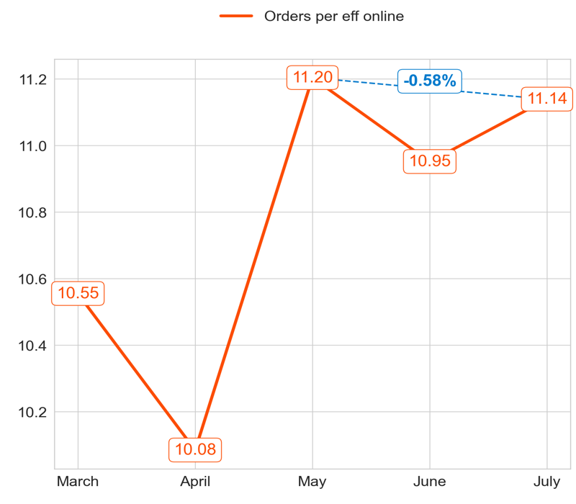
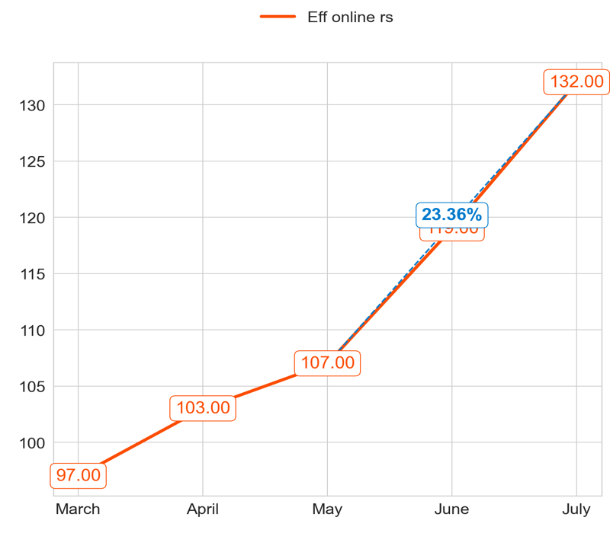
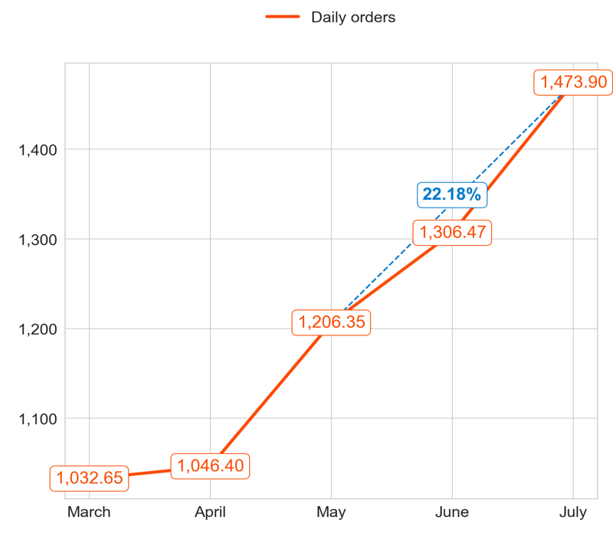
PERFORMANCE
Action Title
Priority 1 -
Comments
Highest: 11.20, Lowest: 10.08
Mean of the last 4 months: 10.84
Highest: 132.00, Lowest: 97.00
Mean of the last 4 months: 115.25
Highest: 1,473.90, Lowest: 1,032.65
Mean of the last 4 months: 1,258.28

Slide 15
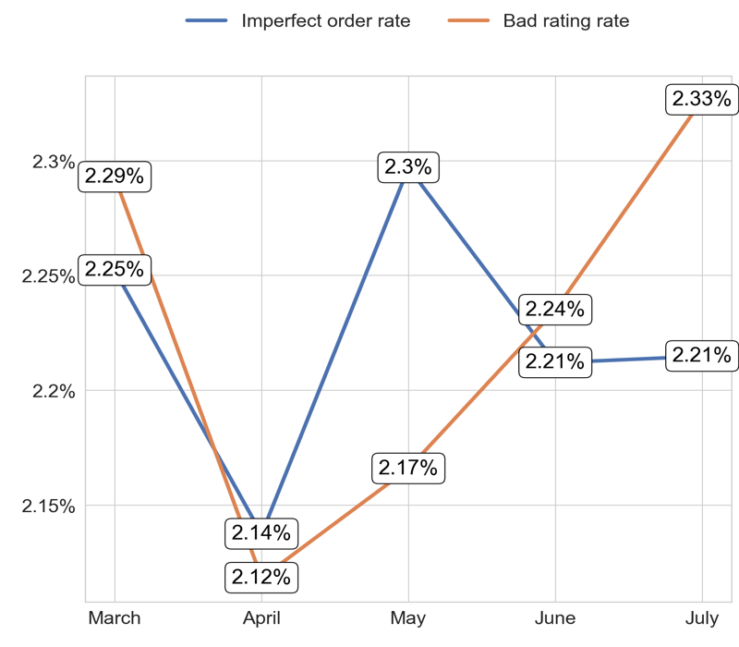
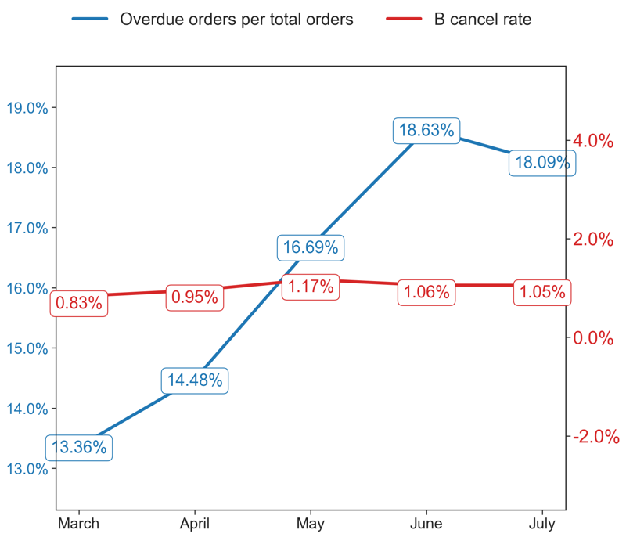
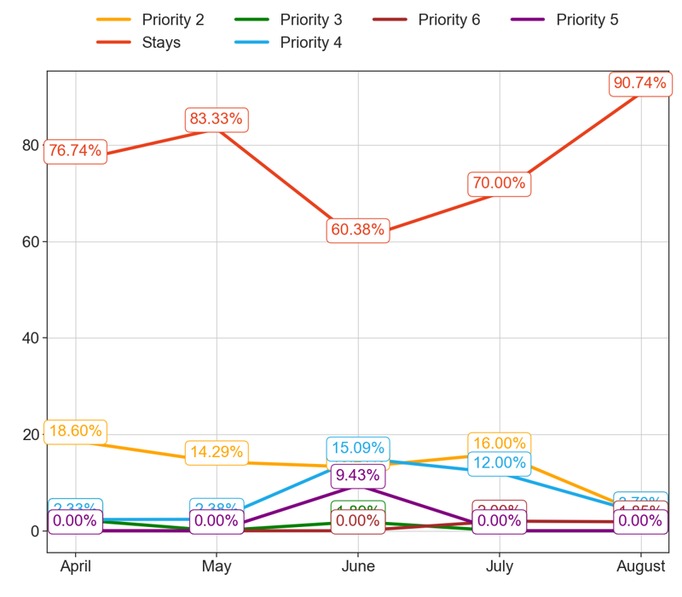
SERVICE
Action Title
Priority 1 -
Comments
Imperfect order rate average in the last 4 months: 2.22 % and the percentage change between the last 2 months: 0.12%.
Bad rating rate average in the last 4 months: 2.23 % and the percentage change between the last 2 months: 4.22%.
Overdue orders per total orders average in the last 4 months: 16.25 % and the percentage change between the last 2 months: -3.22%.
B cancel rate average in the last 4 months: 1.01 % and the percentage change between the last 2 months: -0.14%.
No comments

Slide 16
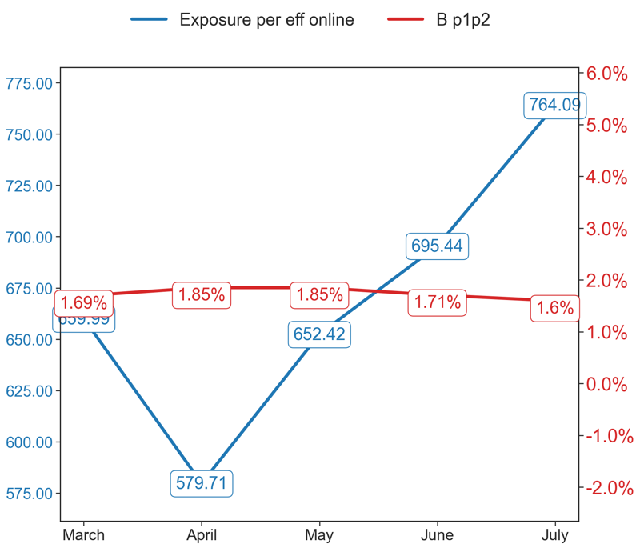
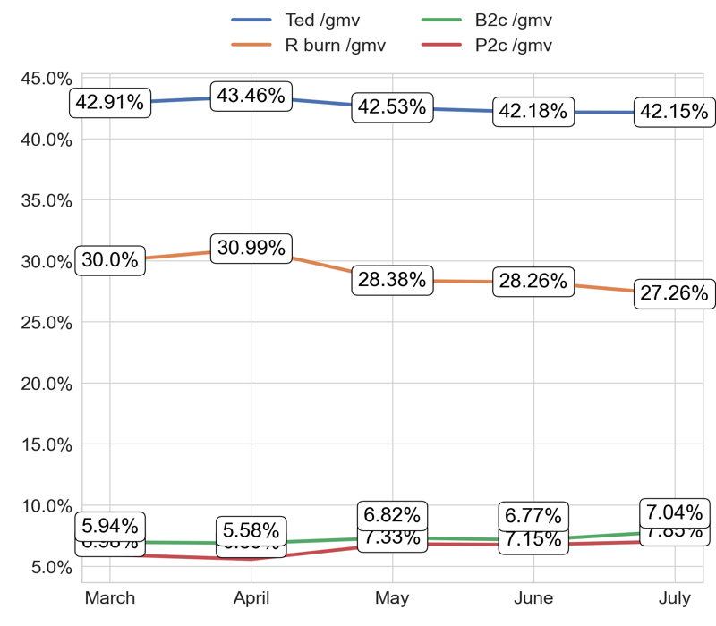
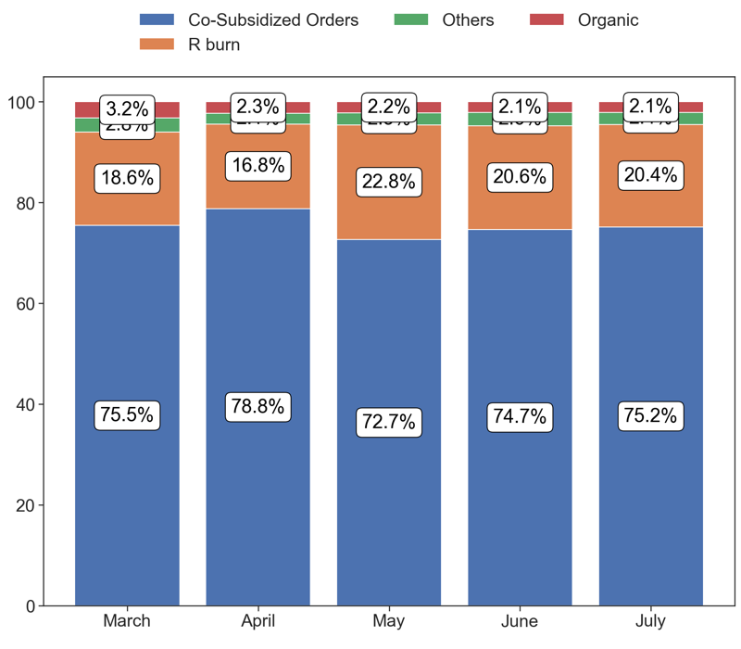
EXPOSURE AND BURN
Action Title
Priority 1 -
Comments
Exposure per eff online average in the last 4 months: 67033.06 % and the percentage change between the last 2 months: 10.52%.
B p1p2 average in the last 4 months: 1.74 % and the percentage change between the last 2 months: -5.89%.
No comments
Last Month Data:
Co-Subsidized Orders: 1,108 orders
R burn: 300 orders
Others: 35 orders
Organic: 31 orders

Slide 17
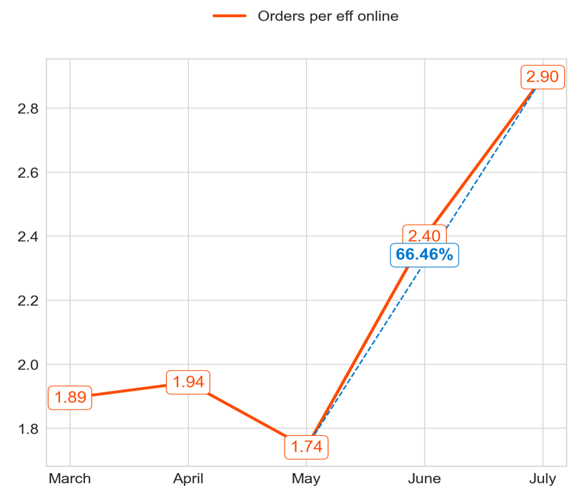
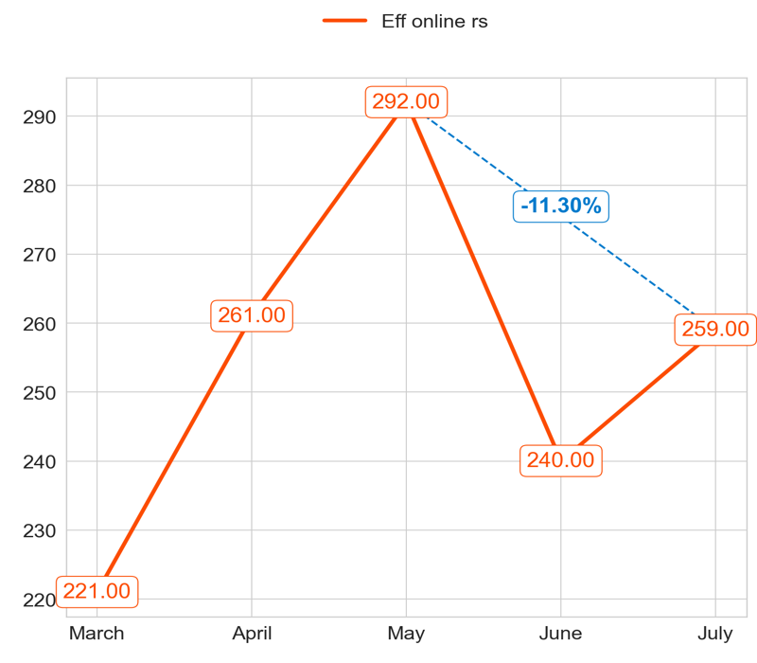
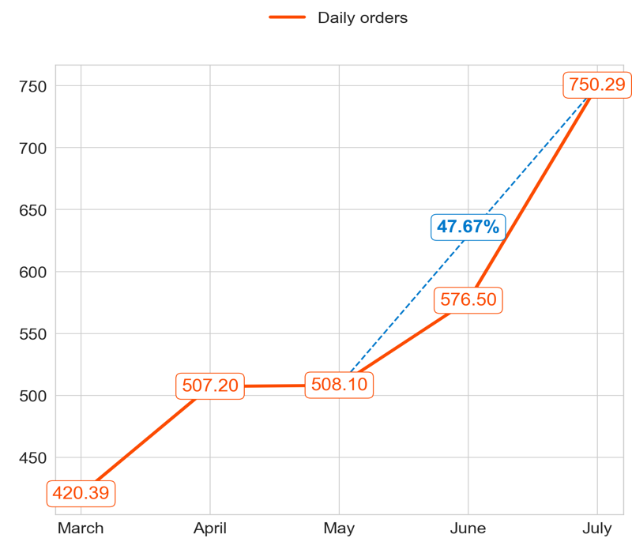
PERFORMANCE
Action Title
Priority 2 -
Comments
Highest: 2.90, Lowest: 1.74
Mean of the last 4 months: 2.24
Highest: 292.00, Lowest: 221.00
Mean of the last 4 months: 263.00
Highest: 750.29, Lowest: 420.39
Mean of the last 4 months: 585.52

Slide 18



SERVICE
Action Title
Priority 2 -
Comments
Imperfect order rate average in the last 4 months: 2.79 % and the percentage change between the last 2 months: 1.91%.
Bad rating rate average in the last 4 months: 2.94 % and the percentage change between the last 2 months: -3.38%.
Overdue orders per total orders average in the last 4 months: 16.53 % and the percentage change between the last 2 months: 3.54%.
B cancel rate average in the last 4 months: 2.9 % and the percentage change between the last 2 months: -21.15%.
No comments

Slide 19



EXPOSURE AND BURN
Action Title
Priority 2 -
Comments
Exposure per eff online average in the last 4 months: 28829.54 % and the percentage change between the last 2 months: 24.97%.
B p1p2 average in the last 4 months: 0.88 % and the percentage change between the last 2 months: -0.63%.
No comments
Last Month Data:
Co-Subsidized Orders: 497 orders
R burn: 175 orders
Others: 53 orders
Organic: 40 orders

Slide 20



PERFORMANCE
Action Title
Priority 3 -
Comments
Highest: 1.14, Lowest: 0.48
Mean of the last 4 months: 0.76
Highest: 113.00, Lowest: 82.00
Mean of the last 4 months: 86.25
Highest: 93.23, Lowest: 45.17
Mean of the last 4 months: 65.30

Slide 21



SERVICE
Action Title
Priority 3 -
Comments
Imperfect order rate average in the last 4 months: 2.49 % and the percentage change between the last 2 months: -20.22%.
Bad rating rate average in the last 4 months: 2.8 % and the percentage change between the last 2 months: -16.33%.
Overdue orders per total orders average in the last 4 months: 19.59 % and the percentage change between the last 2 months: -7.7%.
B cancel rate average in the last 4 months: 2.98 % and the percentage change between the last 2 months: -9.58%.
No comments

Slide 22



EXPOSURE AND BURN
Action Title
Priority 3 -
Comments
Exposure per eff online average in the last 4 months: 22106.24 % and the percentage change between the last 2 months: 19.06%.
B p1p2 average in the last 4 months: 0.38 % and the percentage change between the last 2 months: 21.07%.
No comments
Last Month Data:
Co-Subsidized Orders: 50 orders
R burn: 23 orders
Others: 13 orders
Organic: 7 orders

Slide 23



PERFORMANCE
Action Title
Priority 4 -
Comments
Highest: 2.21, Lowest: 1.06
Mean of the last 4 months: 1.52
Highest: 127.00, Lowest: 71.00
Mean of the last 4 months: 97.25
Highest: 247.87, Lowest: 92.81
Mean of the last 4 months: 146.53

Slide 24



SERVICE
Action Title
Priority 4 -
Comments
Imperfect order rate average in the last 4 months: 2.85 % and the percentage change between the last 2 months: -23.34%.
Bad rating rate average in the last 4 months: 2.83 % and the percentage change between the last 2 months: -2.04%.
Overdue orders per total orders average in the last 4 months: 15.69 % and the percentage change between the last 2 months: -3.56%.
B cancel rate average in the last 4 months: 2.95 % and the percentage change between the last 2 months: 1.79%.
No comments

Slide 25



EXPOSURE AND BURN
Action Title
Priority 4 -
Comments
Exposure per eff online average in the last 4 months: 30721.99 % and the percentage change between the last 2 months: -7.79%.
B p1p2 average in the last 4 months: 0.61 % and the percentage change between the last 2 months: -26.9%.
No comments
Last Month Data:
Co-Subsidized Orders: 5 orders
R burn: 67 orders
Others: 11 orders
Organic: 9 orders

Slide 26


PERFORMANCE
Action Title
Country overview -
Comments
Last Month Data:
New Rs: 100.58, Priority 1: 1,473.90, Priority 2: 750.29, Priority 3: 93.23, Priority 4: 92.81, Priority 5: 224.74
Last Month Data:
New Rs: 47.00, Priority 1: 132.00, Priority 2: 259.00, Priority 3: 82.00, Priority 4: 71.00, Priority 5: 637.00

Slide 27




PERFORMANCE
Action Title
Priority 1 -
Comments
Highest: 16.15, Lowest: 12.33
Mean of the last 4 months: 14.30
Highest: 100.00, Lowest: 73.00
Mean of the last 4 months: 85.00
Highest: 1,242.58, Lowest: 1,056.32
Mean of the last 4 months: 1,211.36

Slide 28



SERVICE
Action Title
Priority 1 -
Comments
Imperfect order rate average in the last 4 months: 2.0 % and the percentage change between the last 2 months: 0.39%.
Bad rating rate average in the last 4 months: 2.1 % and the percentage change between the last 2 months: -4.7%.
Overdue orders per total orders average in the last 4 months: 14.35 % and the percentage change between the last 2 months: -21.53%.
B cancel rate average in the last 4 months: 0.77 % and the percentage change between the last 2 months: 8.45%.
No comments

Slide 29



EXPOSURE AND BURN
Action Title
Priority 1 -
Comments
Exposure per eff online average in the last 4 months: 90283.45 % and the percentage change between the last 2 months: -16.35%.
B p1p2 average in the last 4 months: 1.67 % and the percentage change between the last 2 months: 3.58%.
No comments
Last Month Data:
Co-Subsidized Orders: 923 orders
R burn: 251 orders
Others: 21 orders
Organic: 49 orders

Slide 30



PERFORMANCE
Action Title
Priority 2 -
Comments
Highest: 3.26, Lowest: 2.95
Mean of the last 4 months: 3.11
Highest: 171.00, Lowest: 137.00
Mean of the last 4 months: 165.25
Highest: 550.81, Lowest: 440.35
Mean of the last 4 months: 515.13

Slide 31



SERVICE
Action Title
Priority 2 -
Comments
Imperfect order rate average in the last 4 months: 2.47 % and the percentage change between the last 2 months: -14.77%.
Bad rating rate average in the last 4 months: 2.34 % and the percentage change between the last 2 months: -23.09%.
Overdue orders per total orders average in the last 4 months: 17.6 % and the percentage change between the last 2 months: -14.63%.
B cancel rate average in the last 4 months: 2.95 % and the percentage change between the last 2 months: 20.19%.
No comments

Slide 32



EXPOSURE AND BURN
Action Title
Priority 2 -
Comments
Exposure per eff online average in the last 4 months: 35708.61 % and the percentage change between the last 2 months: -6.67%.
B p1p2 average in the last 4 months: 0.99 % and the percentage change between the last 2 months: 5.19%.
No comments
Last Month Data:
Co-Subsidized Orders: 298 orders
R burn: 193 orders
Others: 21 orders
Organic: 50 orders

Slide 33



PERFORMANCE
Action Title
Priority 3 -
Comments
Highest: 1.47, Lowest: 0.46
Mean of the last 4 months: 0.81
Highest: 151.00, Lowest: 8.00
Mean of the last 4 months: 105.25
Highest: 103.19, Lowest: 12.97
Mean of the last 4 months: 64.88

Slide 34



SERVICE
Action Title
Priority 3 -
Comments
Imperfect order rate average in the last 4 months: 2.68 % and the percentage change between the last 2 months: -21.87%.
Bad rating rate average in the last 4 months: 2.37 % and the percentage change between the last 2 months: -26.96%.
Overdue orders per total orders average in the last 4 months: 22.47 % and the percentage change between the last 2 months: -37.68%.
B cancel rate average in the last 4 months: 4.39 % and the percentage change between the last 2 months: -0.37%.
No comments

Slide 35



EXPOSURE AND BURN
Action Title
Priority 3 -
Comments
Exposure per eff online average in the last 4 months: 19484.55 % and the percentage change between the last 2 months: 6.03%.
B p1p2 average in the last 4 months: 0.47 % and the percentage change between the last 2 months: 6.38%.
No comments
Last Month Data:
Co-Subsidized Orders: 46 orders
R burn: 42 orders
Others: 5 orders
Organic: 11 orders

Slide 36



PERFORMANCE
Action Title
Priority 4 -
Comments
Highest: 2.08, Lowest: 1.53
Mean of the last 4 months: 1.69
Highest: 160.00, Lowest: 94.00
Mean of the last 4 months: 136.50
Highest: 305.39, Lowest: 144.32
Mean of the last 4 months: 235.02

Slide 37



SERVICE
Action Title
Priority 4 -
Comments
Imperfect order rate average in the last 4 months: 2.27 % and the percentage change between the last 2 months: -11.51%.
Bad rating rate average in the last 4 months: 2.33 % and the percentage change between the last 2 months: 4.75%.
Overdue orders per total orders average in the last 4 months: 18.09 % and the percentage change between the last 2 months: -7.65%.
B cancel rate average in the last 4 months: 2.71 % and the percentage change between the last 2 months: 35.29%.
No comments

Slide 38



EXPOSURE AND BURN
Action Title
Priority 4 -
Comments
Exposure per eff online average in the last 4 months: 33624.3 % and the percentage change between the last 2 months: -11.58%.
B p1p2 average in the last 4 months: 0.6 % and the percentage change between the last 2 months: 0.83%.
No comments
Last Month Data:
Co-Subsidized Orders: 0 orders
R burn: 99 orders
Others: 16 orders
Organic: 30 orders

Slide 39


PERFORMANCE
Action Title
Country overview -
Comments
Last Month Data:
New Rs: 64.94, Priority 1: 1,242.58, Priority 2: 550.81, Priority 3: 103.19, Priority 4: 144.32, Priority 5: 130.23
Last Month Data:
New Rs: 36.00, Priority 1: 100.00, Priority 2: 171.00, Priority 3: 151.00, Priority 4: 94.00, Priority 5: 387.00

